Slide 1
ATAI
Advanced Technique of Artificial Intelligence
ATAI
ChongqingUniversity _{AdvancedTechniqueof}
of Technology Artificial Intelligence
Chongqing University of
Technology
Chongqing University ^{ATAI}
_{of Technology} Advanced Techniqueof
Artificial Intelligence
Chongqing University of Technology
Chongqing University of Technology
Enhancing New-item Fairness in Dynamic Recommender Systems
Code:https://github.com/Grey- z/FairAgent
——SIGIR_2025
Reported by Jingbo Liu
1

Slide 2
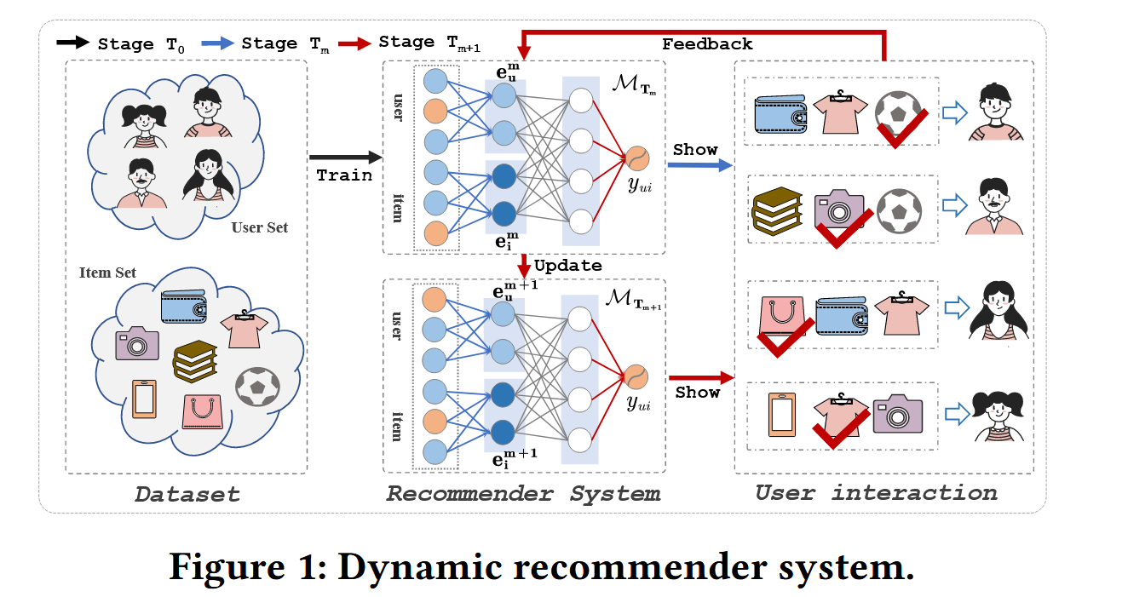
ATAI
Advanced Technique of Artificial Intelligence
ATAI
ChongqingUniversity _{AdvancedTechniqueof}
of Technology Artificial Intelligence
Chongqing University of
Technology
Chongqing University ^{ATAI}
_{of Technology} Advanced Techniqueof
Artificial Intelligence
Chongqing University of Technology
Chongqing University of Technology
Motivation
1) First, the continuous introduction of new-items in DRSs requires optimization objectives to adapt over time. Existing methods are primarily designed for static scenarios [10, 43], meaning they lack the flexibility to adjust to dynamic changes in item pools and user interactions.
2)Second, users’ personalized preferences for new-items evolve over time. Existing studies on item fairness neglect users’ personalized preferences for new-items and also fail to account for the evolution of these preferences in DRSs.

Slide 3
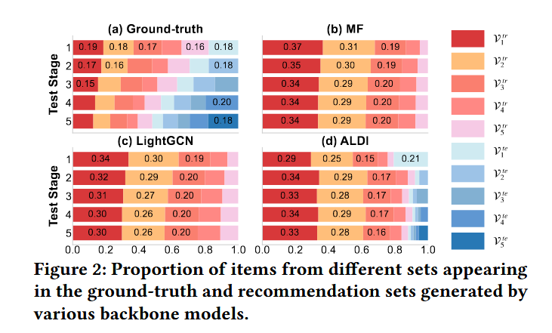
ATAI
Advanced Technique of Artificial Intelligence
ATAI
ChongqingUniversity _{AdvancedTechniqueof}
of Technology Artificial Intelligence
Chongqing University of
Technology
Chongqing University ^{ATAI}
_{of Technology} Advanced Techniqueof
Artificial Intelligence
Chongqing University of Technology
Chongqing University of Technology
Motivation
3) Third, users provide ongoing interaction feedback that directly influences subsequent model updates. To maintain recommendation accuracy…they overlook the critical issue of fairness for new-items

Slide 4
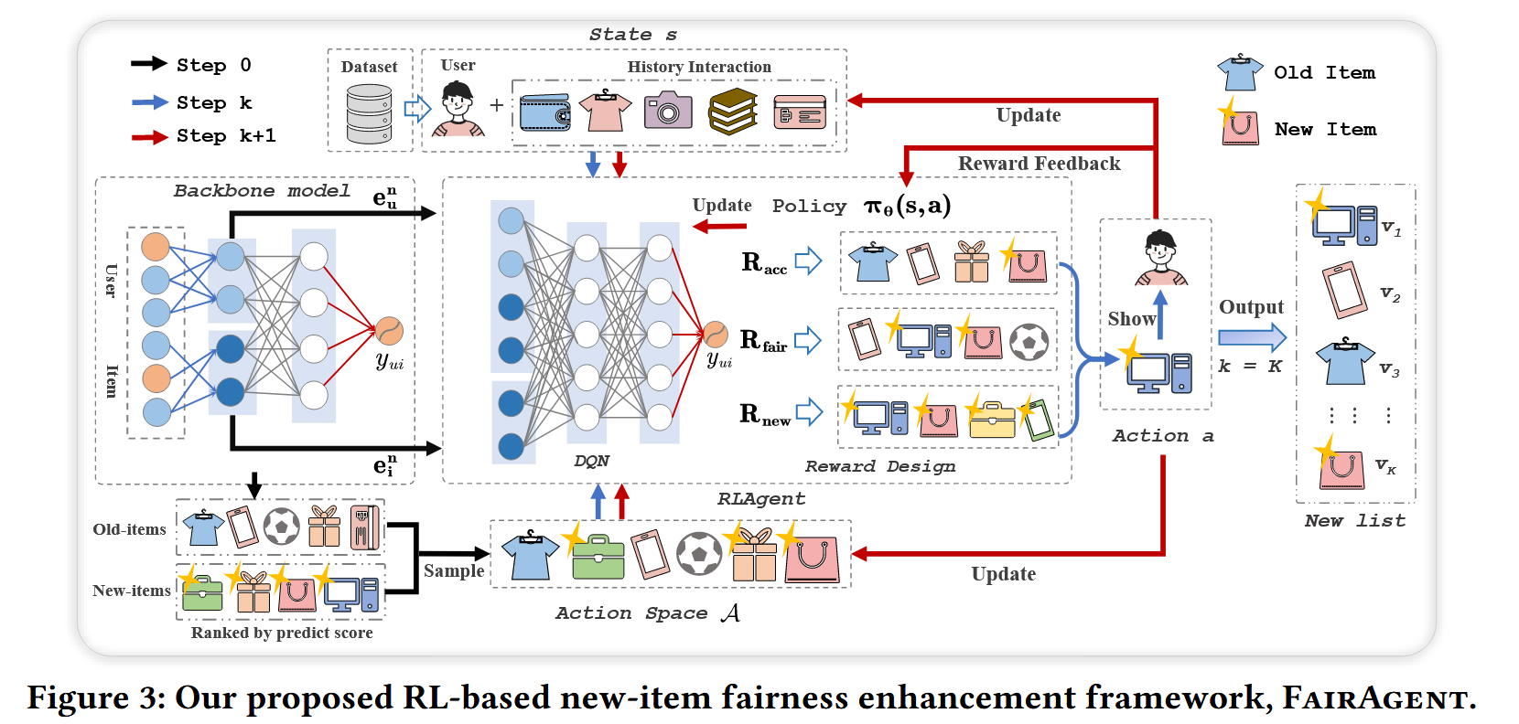
ATAI
Advanced Technique of Artificial Intelligence
ATAI
ChongqingUniversity _{AdvancedTechniqueof}
of Technology Artificial Intelligence
Chongqing University of
Technology
Chongqing University ^{ATAI}
_{of Technology} Advanced Techniqueof
Artificial Intelligence
Chongqing University of Technology
Chongqing University of Technology
Method

Slide 5
ATAI
Advanced Technique of Artificial Intelligence
ATAI
ChongqingUniversity _{AdvancedTechniqueof}
of Technology Artificial Intelligence
Chongqing University of
Technology
Chongqing University ^{ATAI}
_{of Technology} Advanced Techniqueof
Artificial Intelligence
Chongqing University of Technology
Chongqing University of Technology
Method

Slide 6
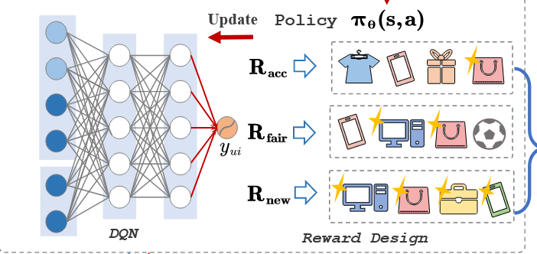
ATAI
Advanced Technique of Artificial Intelligence
ATAI
ChongqingUniversity _{AdvancedTechniqueof}
of Technology Artificial Intelligence
Chongqing University of
Technology
Chongqing University ^{ATAI}
_{of Technology} Advanced Techniqueof
Artificial Intelligence
Chongqing University of Technology
Chongqing University of Technology
Method

Slide 7
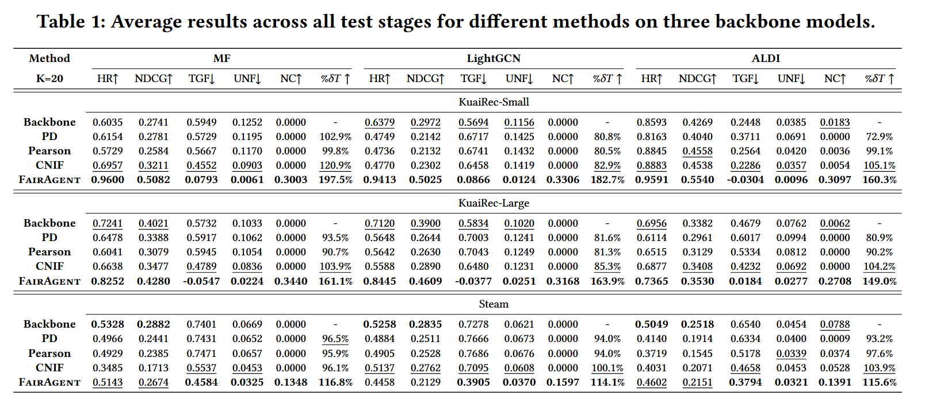
ATAI
Advanced Technique of Artificial Intelligence
ATAI
ChongqingUniversity _{AdvancedTechniqueof}
of Technology Artificial Intelligence
Chongqing University of
Technology
Chongqing University ^{ATAI}
_{of Technology} Advanced Techniqueof
Artificial Intelligence
Chongqing University of Technology
Chongqing University of Technology
Experiments

Slide 8
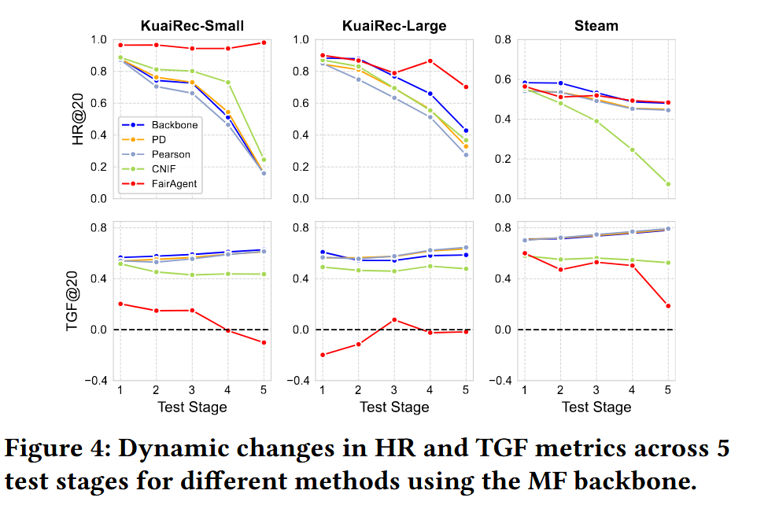
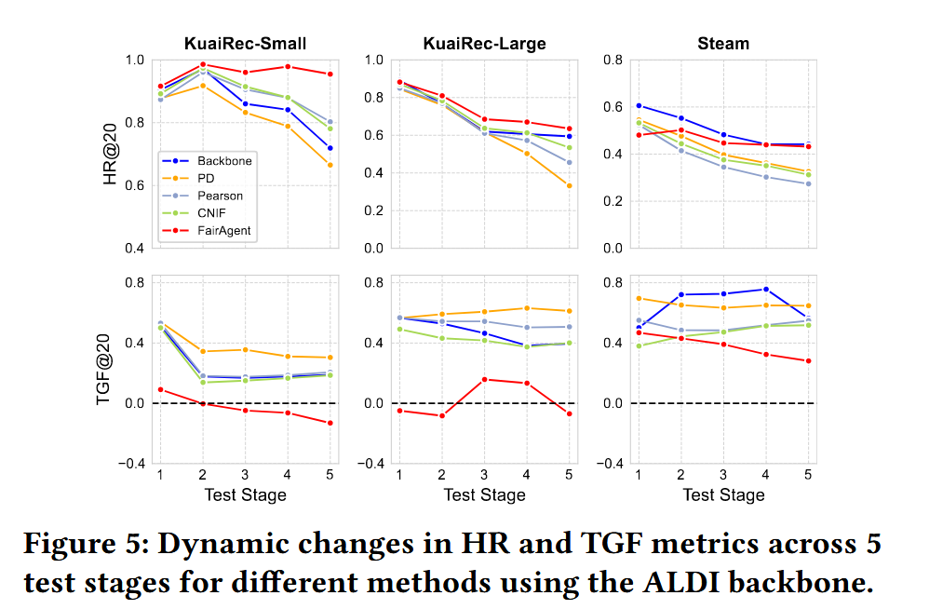
ATAI
Advanced Technique of Artificial Intelligence
ATAI
ChongqingUniversity _{AdvancedTechniqueof}
of Technology Artificial Intelligence
Chongqing University of
Technology
Chongqing University ^{ATAI}
_{of Technology} Advanced Techniqueof
Artificial Intelligence
Chongqing University of Technology
Chongqing University of Technology
Experiments

Slide 9
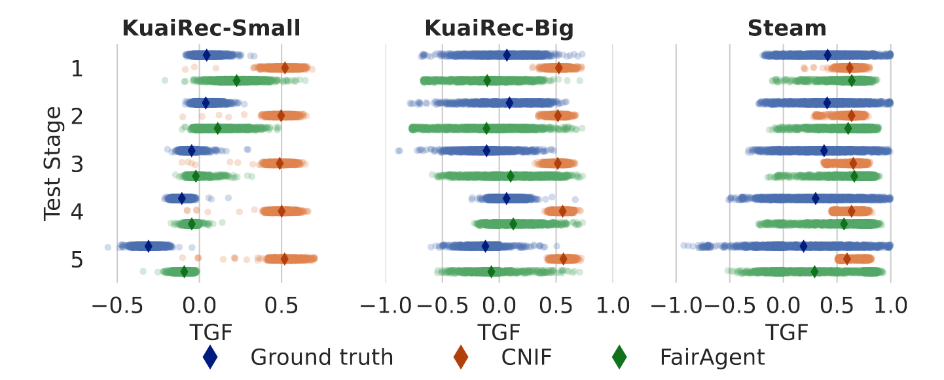
ATAI
Advanced Technique of Artificial Intelligence
ATAI
ChongqingUniversity _{AdvancedTechniqueof}
of Technology Artificial Intelligence
Chongqing University of
Technology
Chongqing University ^{ATAI}
_{of Technology} Advanced Techniqueof
Artificial Intelligence
Chongqing University of Technology
Chongqing University of Technology

Slide 10
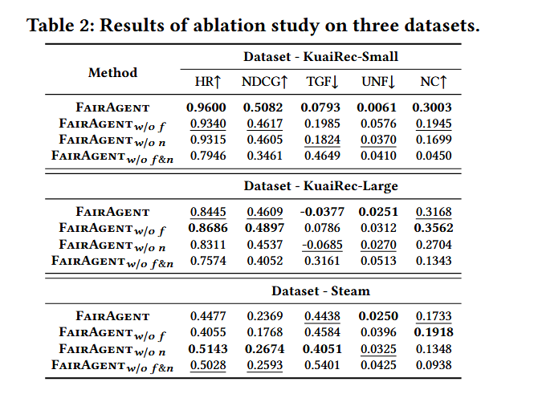
ATAI
Advanced Technique of Artificial Intelligence
ATAI
ChongqingUniversity _{AdvancedTechniqueof}
of Technology Artificial Intelligence
Chongqing University of
Technology
Chongqing University ^{ATAI}
_{of Technology} Advanced Techniqueof
Artificial Intelligence
Chongqing University of Technology
Chongqing University of Technology

Slide 11
ATAI
Advanced Technique of Artificial Intelligence
ATAI
ChongqingUniversity _{AdvancedTechniqueof}
of Technology Artificial Intelligence
Chongqing University of
Technology
Chongqing University ^{ATAI}
_{of Technology} Advanced Techniqueof
Artificial Intelligence
Chongqing University of Technology
Chongqing University of Technology
Thanks!

